Slide 1
Reminders
Study Sessions in SL lobby:
Friday 11am- 12noon (with Catherine Sherman)
Monday 10am- 11am (with Hammad Sadiq)
First Quiz on Tuesday 3/20: will cover Chapters 2, 3 & 4
Anything in the text OR lecture is fair game
Use the ‘chapter objectives’ as study guide
Practice with the ‘odd’ end of chapter questions – the answers are in the back of your text

Slide 2
Chapter 2 Objectives:
Describe the 4 major TYPES of chemical bonds in cells
Identify the 4 major families of small molecules and the macromolecules they make up
Know HOW condensation reactions form these macromolecules and WHAT the resulting bonds are called
Describe how macromolecules are composed and how they interact.

Slide 3
Interacting atoms form molecules
“Strong” interactions
Covalent bonds
More electrons shared = shorter, stronger bond
“Weak” interactions
Non covalent bonds
Ionic bonds
Hydrogen bonds
Hydrophilic interactions and Hydrophobic interactions
Individually weak BUT collectively strong

Slide 4
Small molecules in the cell
What molecules are formed with chemical bonds?
How are they important for the cell?

Slide 5
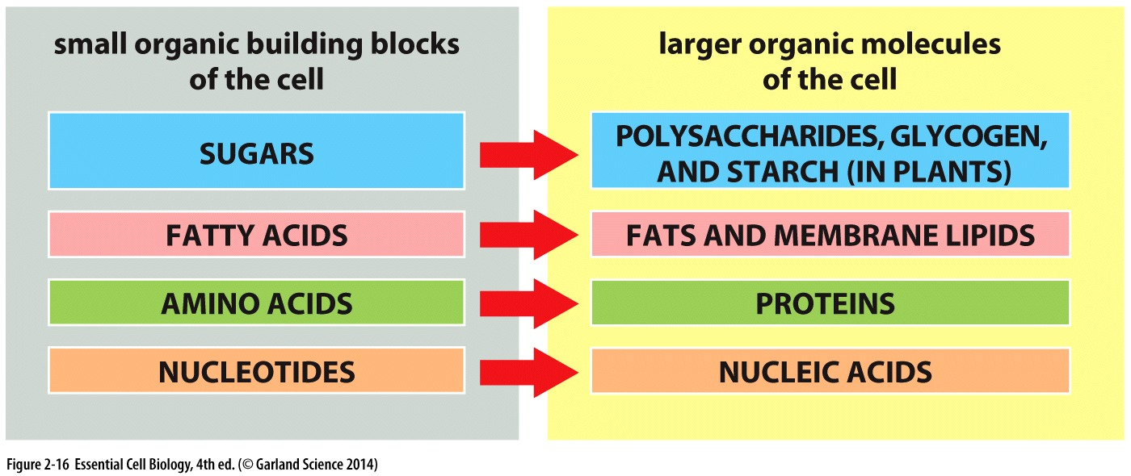
Chemistry to form small molecules in cells
4 major carbon containing compounds in cells:
What subunits are they made of?
How are subunits joined?

Slide 6
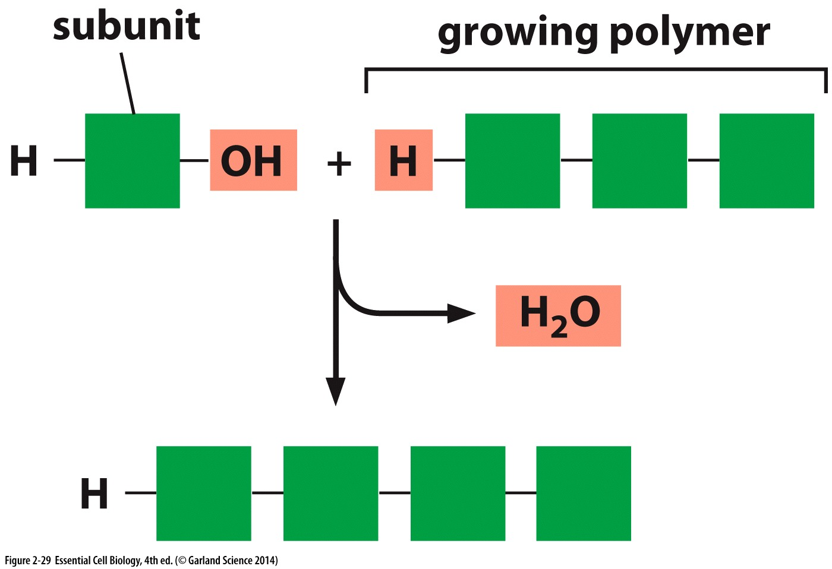
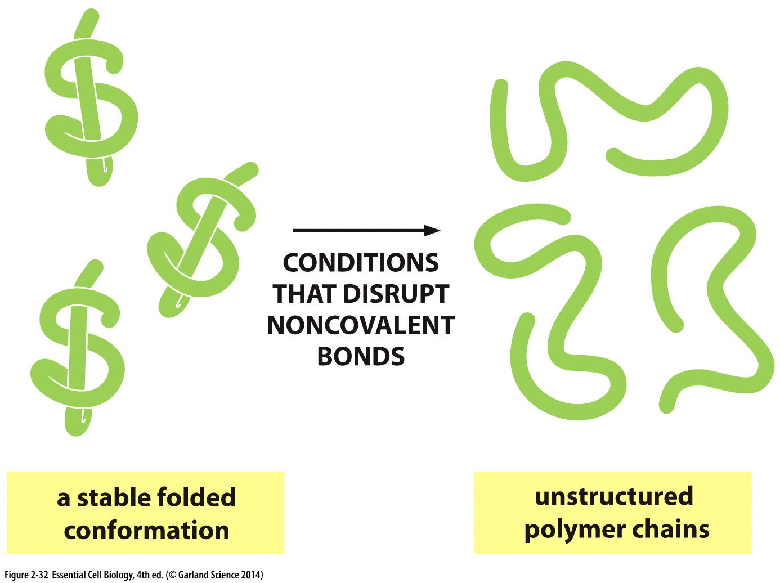
Macromolecules are:
formed by condensation reactions
broken down by hydrolysis reactions
Covalent (strong)bonds:
hold subunits together to form a polymer
Noncovalent (weak) bonds:
Specify shape
Allow them to bind others

Slide 7
Amino Acids

Slide 8
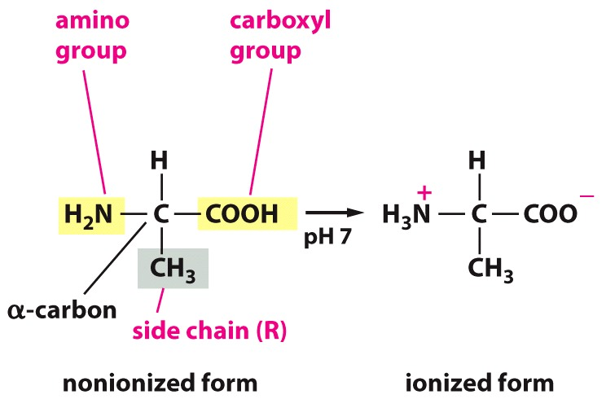
Amino Acids: subunits of proteins
In a cellular environment
20 different amino acids
Shared defining property:
Carboxyl group & Amino group on SAME carbon
Notes:
Defining property: Contain carboxylic acid group and an amino group BOTH linked to the same alpha carbon. The side chain differs between amino acids

Slide 9
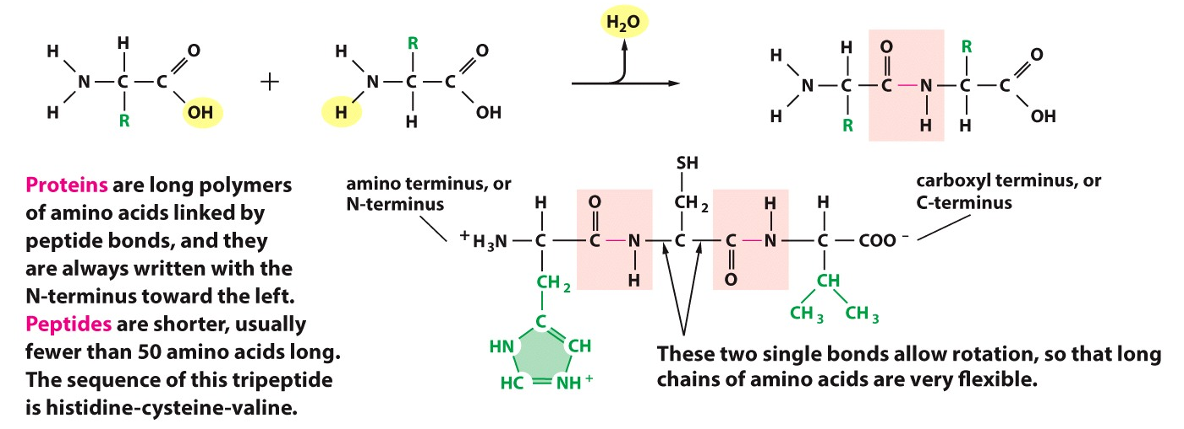
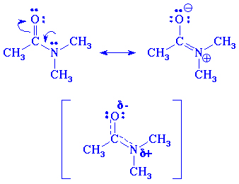
Amino Acids:
Linked through peptide bonds: make proteins
Condensation reaction releases water
No rotation around C-N (peptide) bond
Resonance structures
R= Side chain
Free rotation around these single bonds

Slide 10
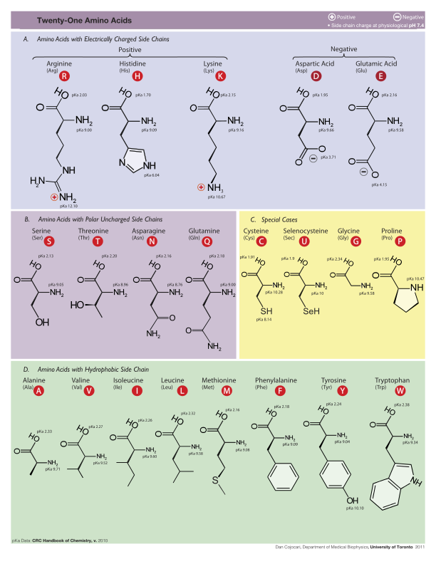
Amino Acids:
Different side chains have different properties
Charges
Hydrophobic
Hydrophilic
Bulky
Ability to form disulfide bonds
Amino acid properties impact function & behavior of protein they compose

Slide 11
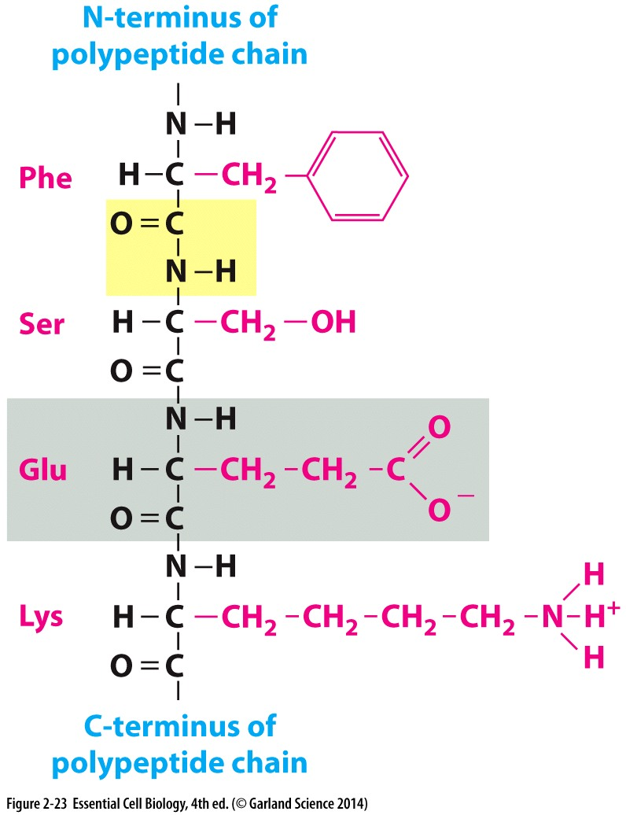
Using what you know about chemical bonds in cell biology
What is highlighted yellow?
What is shown in red?
What types of interactions might you expect each side chain to make?
How might you expect the three dimensional structure of the following polypeptide to look? (hint: think about which bonds allow free rotation)

Slide 12
Sugars

Slide 13
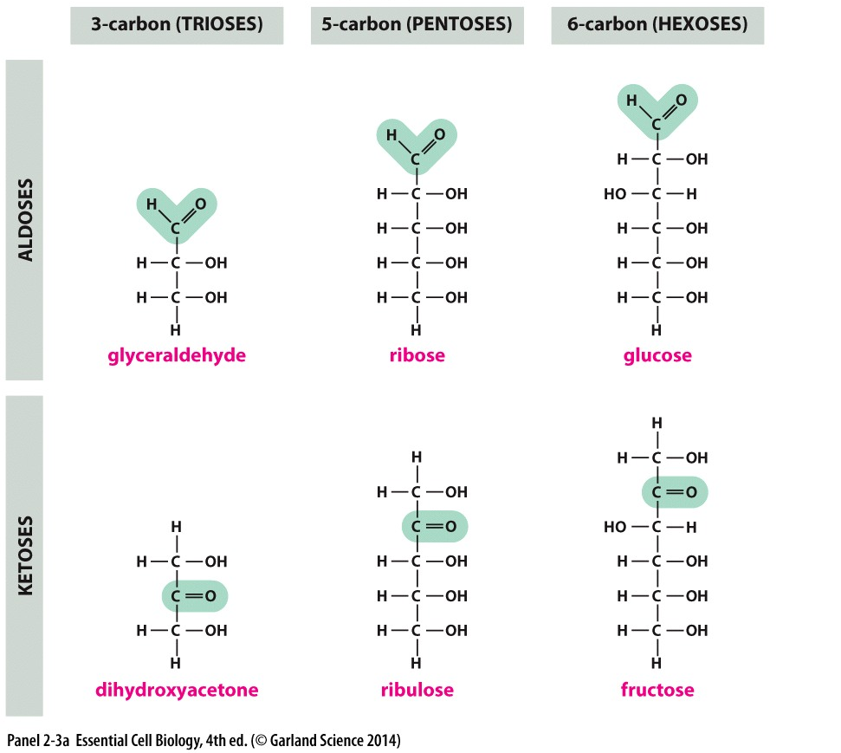
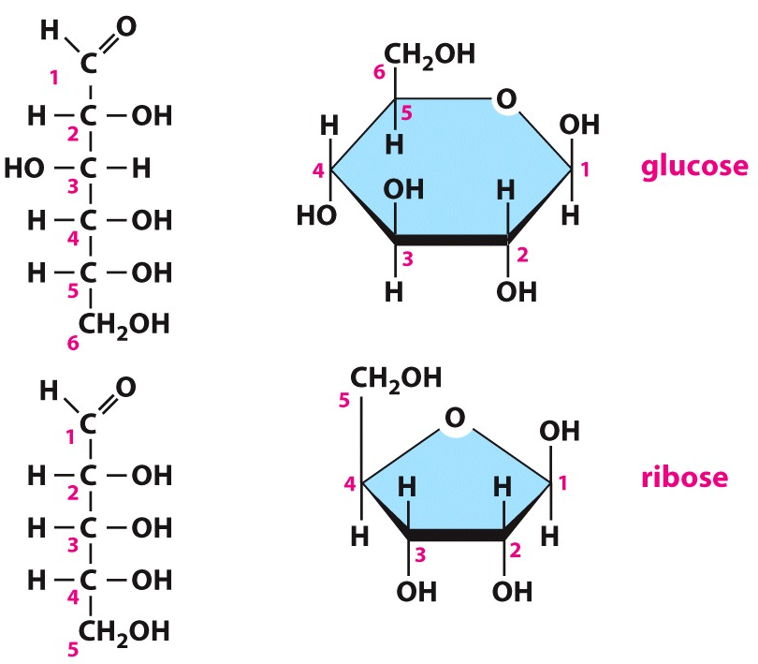
Sugars: Subunits of Polysaccharides
Basic formula of (CH2O)n
2 or more hydroxyl groups (OH = hydroxyl group)
Contain an aldehyde
Or a ketone group
Aldehyde or ketone group reacts with a hydroxyl group to form a ring
Notes:
Sugars are compounds with the general formula (Ch2O)n where n can be 2, 3,4 5, or 6 and have 2 or more hydroxl groups
Draw in aldehyde and ketone groups

Slide 14
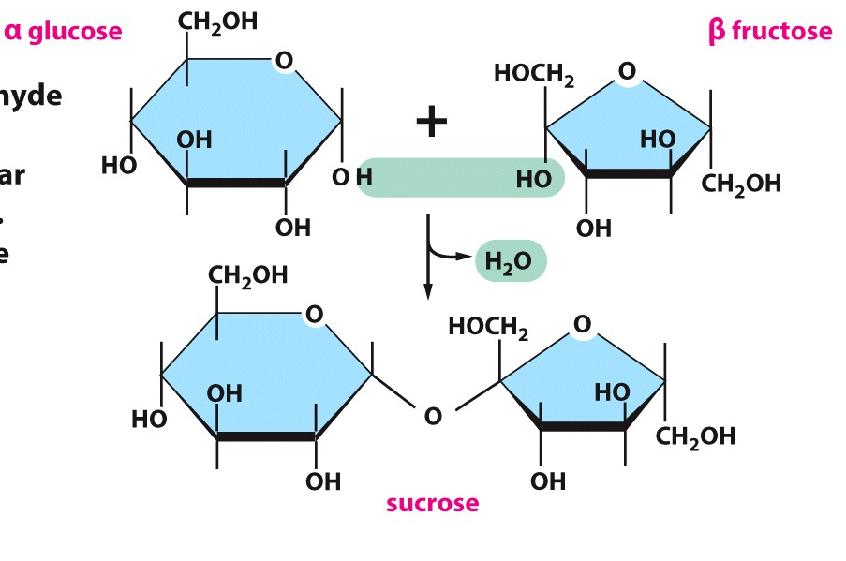
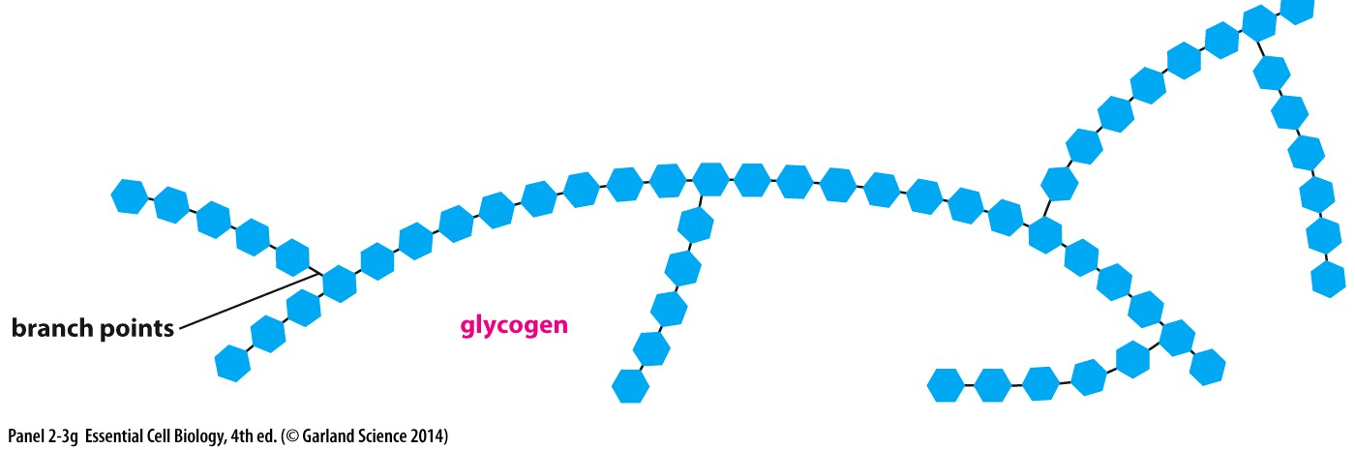
The carbon in a sugar molecule containing the aldehyde or ketone group can react with any hydroxyl group on a second sugar molecule
2 sugar chain
= disaccharide
>2 sugar chain =polysaccharide
Glycosidic Bond

Slide 15
Nucleotides

Slide 16
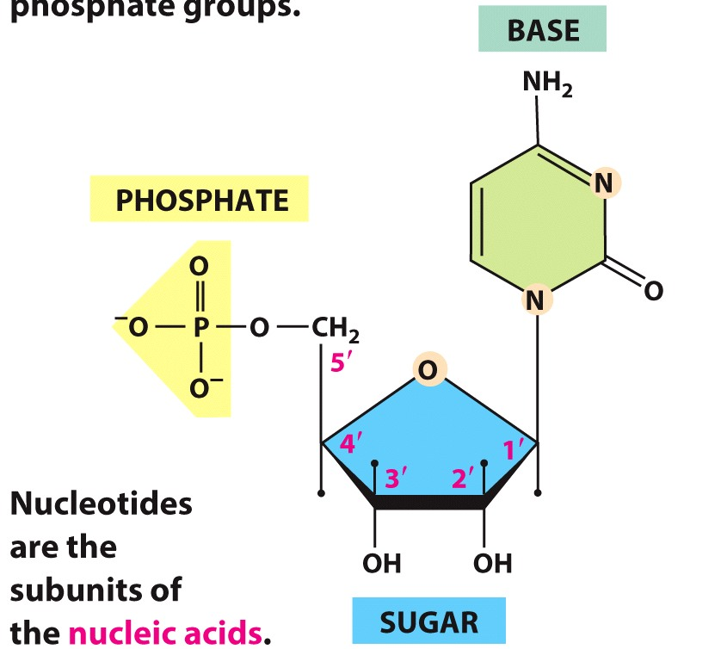
Nucleotides are joined together to make nucleic acids
DNA & RNA
Consist of:
5-carbon sugar
Nitrogen-containing base
1+ phosphate groups
Make the nucleotide negatively charged
N-glycosidic bond
(same place as
sugar-sugar bond)
nucleoside
nucleotide

Slide 17
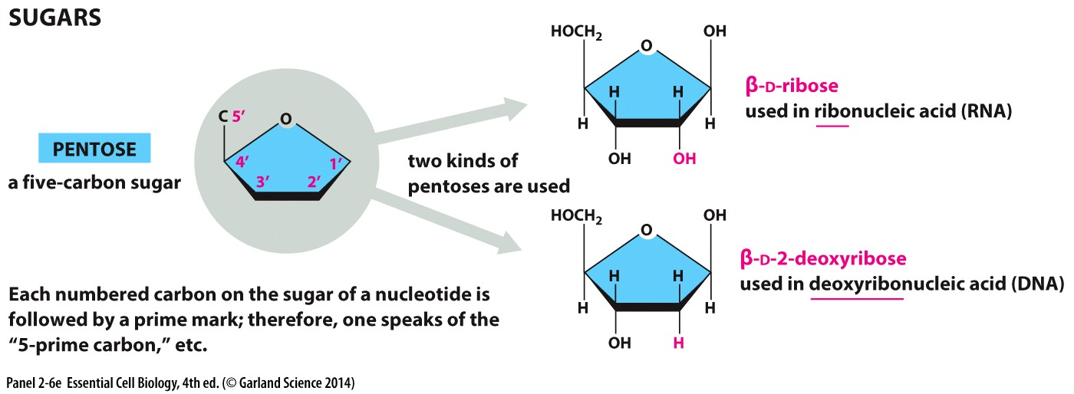
RNA and DNA differ in the type of pentose sugar used

Slide 18
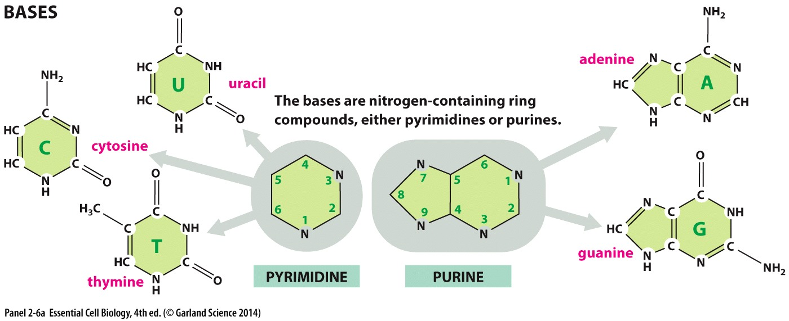
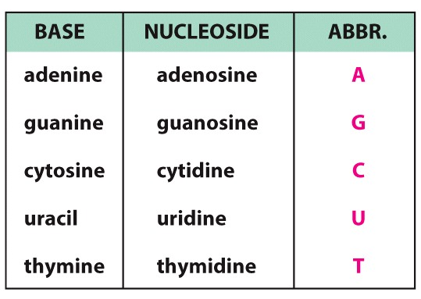
Both RNA and DNA
Just RNA
Just DNA

Slide 19
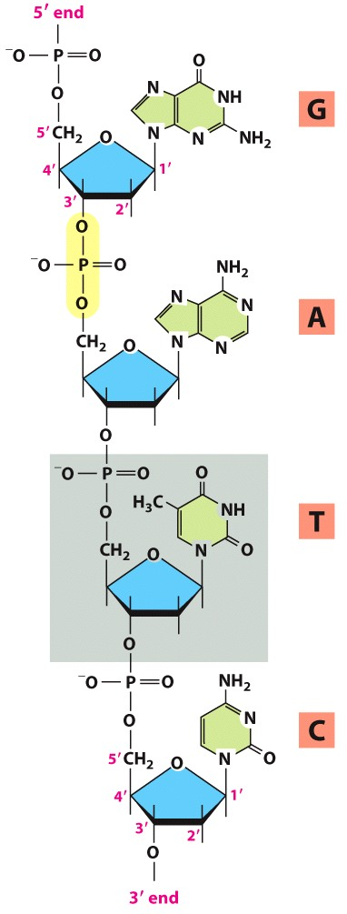
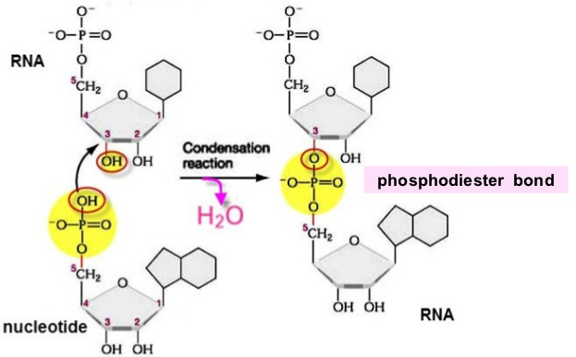
Nucleotides are joined through a condensation reaction
Result in a phosphodiester bond
Nucleotide chains grow 5’→3’

Slide 20
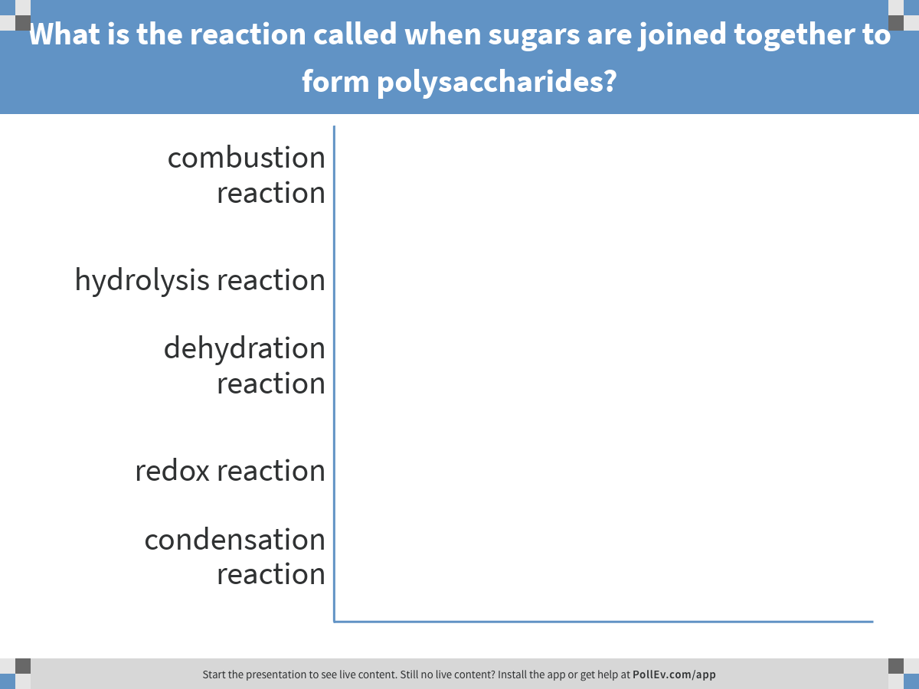
Monomers of small molecules are joined together to form polymers:
Notes:
What is the reaction called when sugars are joined together to form polysaccharides?
https://www.polleverywhere.com/multiple_choice_polls/KfvKA8Lw2nC3mci

Slide 21
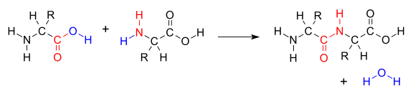
Monomers of small molecules are joined together to form polymers: What is the reaction by which sugars are joined together to form polysaccharides?
Condensation reaction:
when 2 molecules are joined together to form a larger molecule
together with the loss of a small molecule
Dehydration reaction:
Condensation reaction where the small molecule is water

Slide 22
Fatty Acids

Slide 23
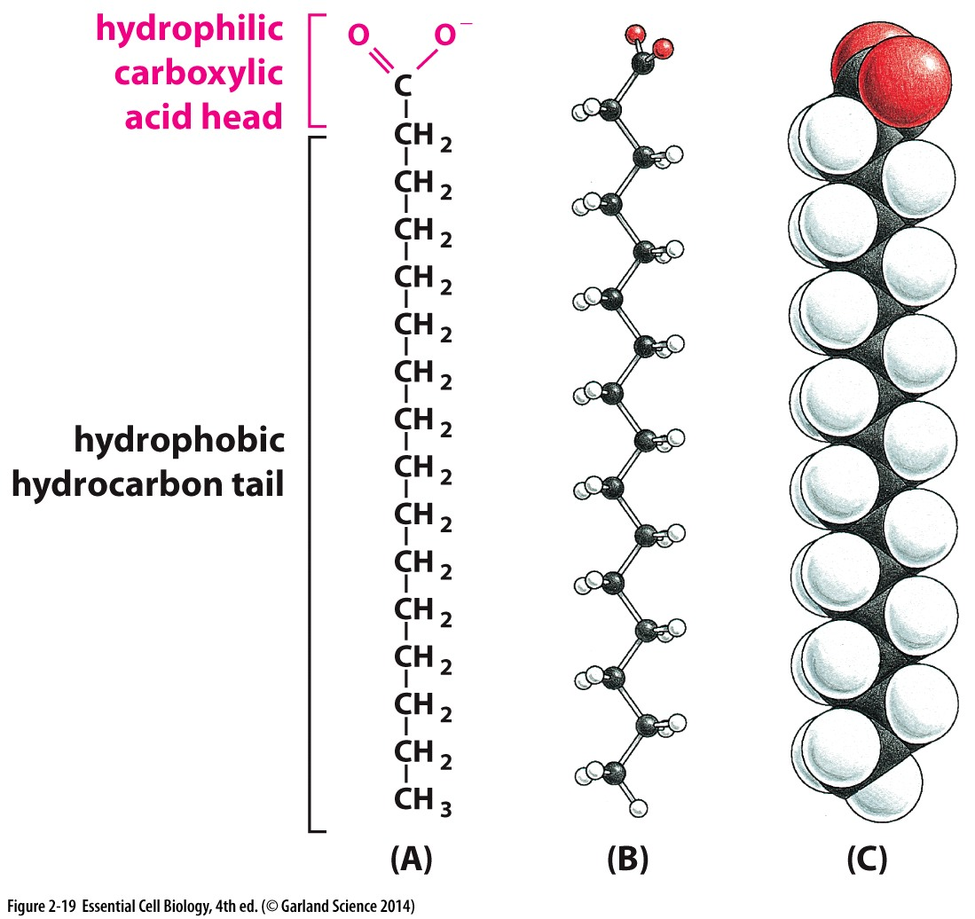
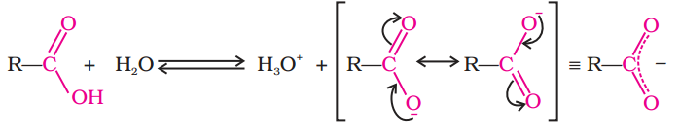
Fatty Acid Chains:
Components of Cell membranes
Hydrophilic head group
Interacts with aqueous environment
Hydrophobic hydrocarbon tail
Avoids aqueous environments
Carboxyl group is ionized in an aqueous environment
Notes:
Fatty acids have 2 chemically distinct regions: long hydrocarbon chain which is hydrophobic and not chemically reactive, and a carboxyl group which behaves as an acid and is ionized in an aqueous solution

Slide 24
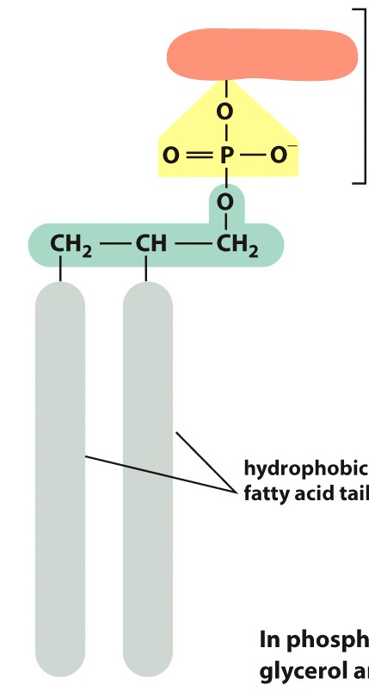
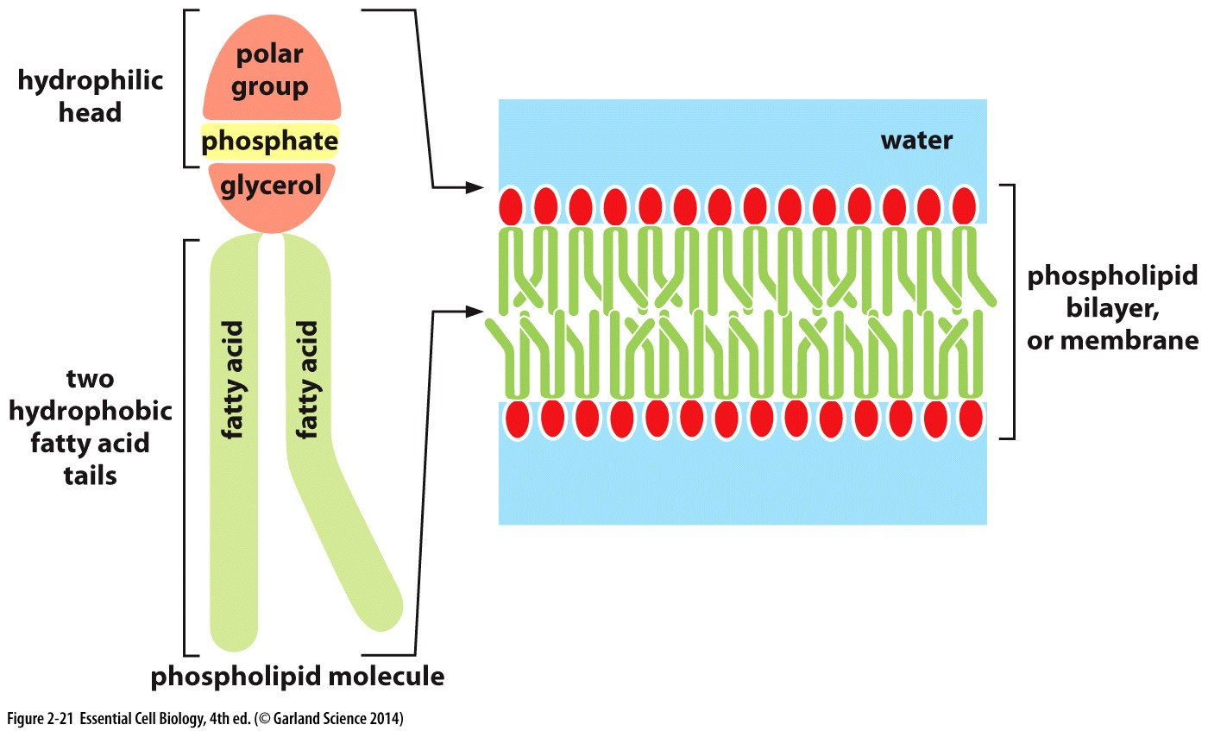
Making a lipid membrane:
Polar group
Phosphoric acid
Other lipids include steroids like cholesterol and testosterone
Notes:
Distinct properties of the hydrophilic head group and hyrophobic tail group facilitate the aggregation of phospoholipids. They arrange so as to protect the hydrophobic regions from the aquoeus environment- results in lipid bilayers or monolayers

Slide 25
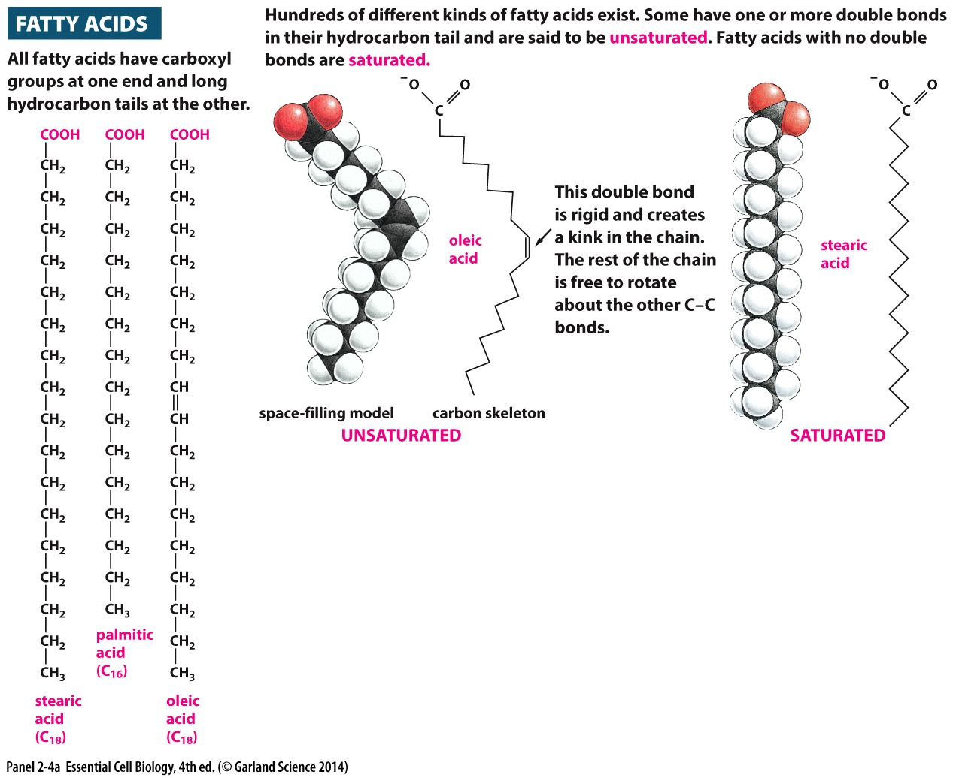
Fatty Acid Chains:
Hydrocarbon tails:
Saturated: no double bonds
Unsaturated/polyunsaturated: one or more double bonds between carbons
Notes:
Fatty acids have 2 chemically distinct regions: long hydrocarbon chain which is hydrophobic and not chemically reactive, and a carboxyl group which behaves as an acid and is ionized in an aqueous solution

Slide 26
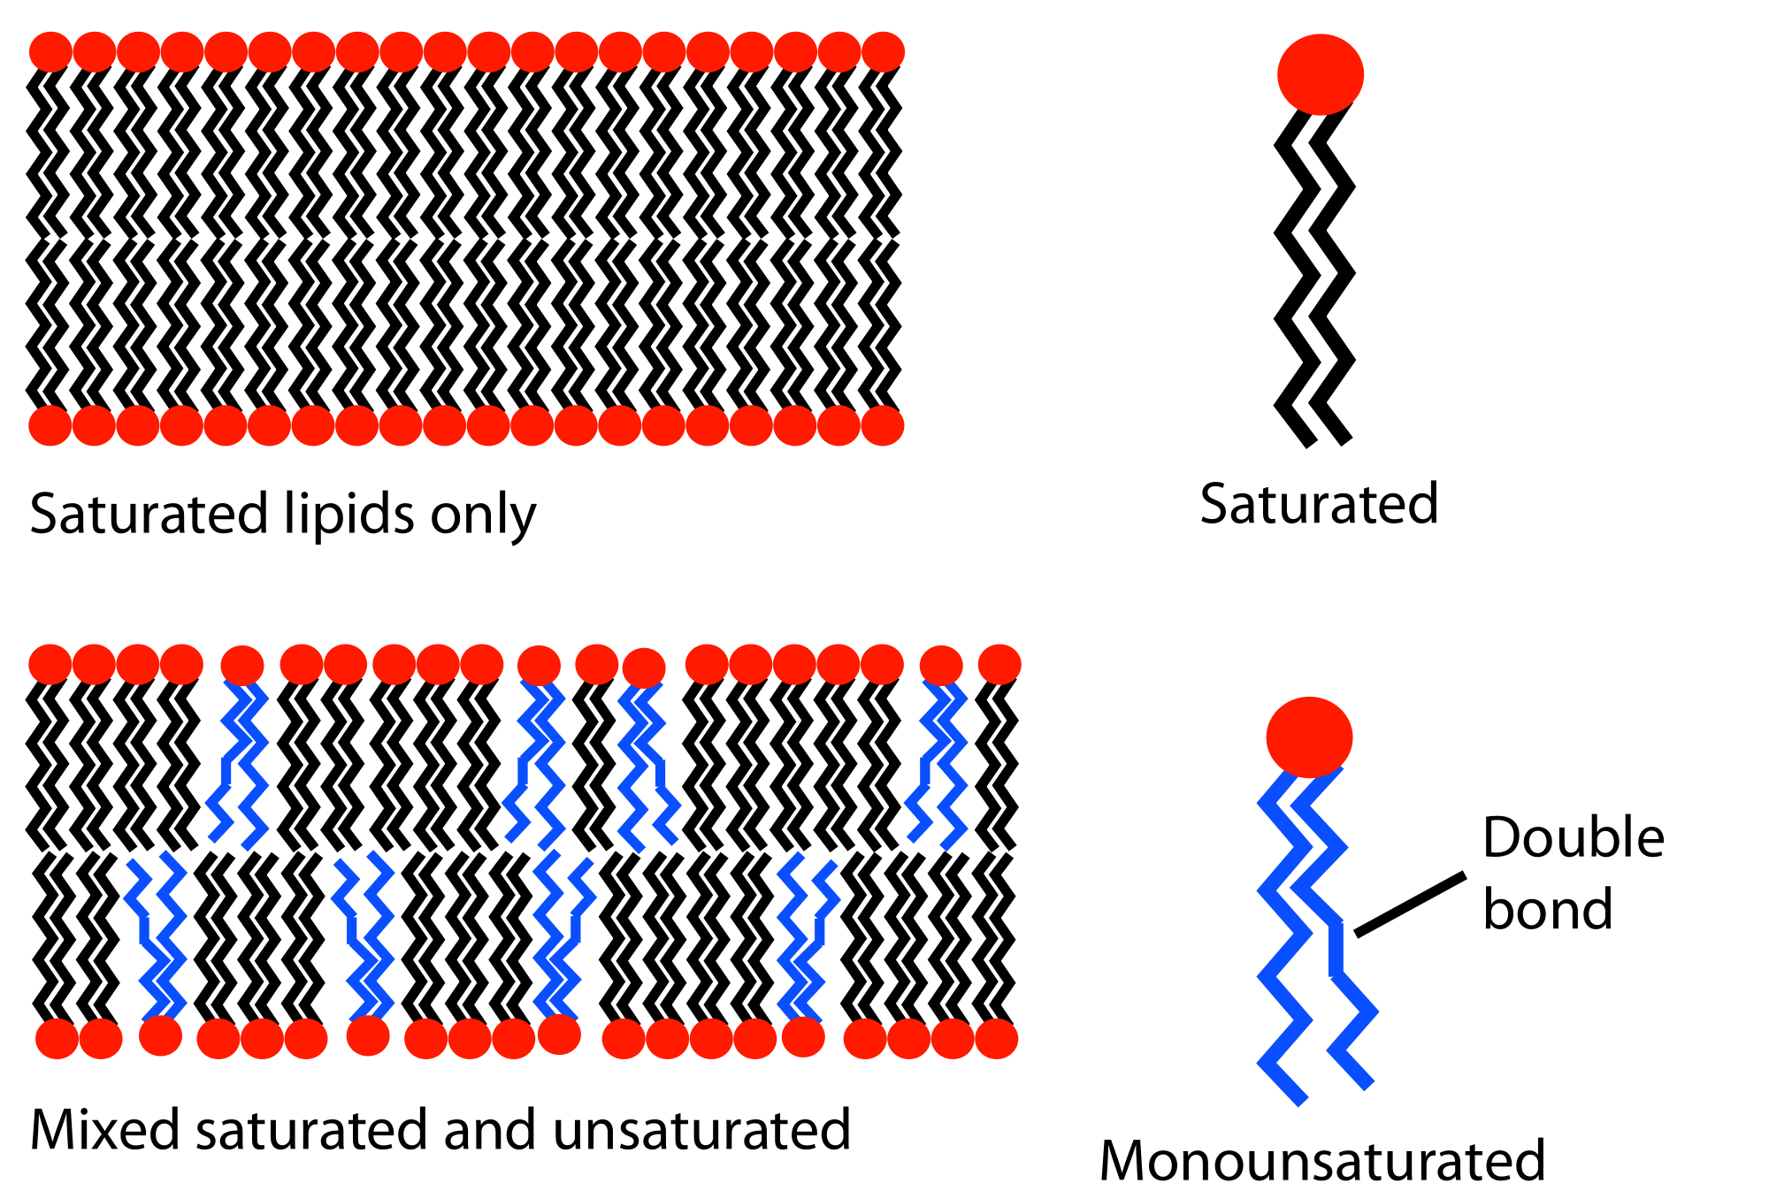
Phospholipids
Components of Cell membranes
Hydrocarbon tails:
Saturated: no double bonds
Linear, can tightly pack together
Unsaturated/polyunsaturated: one or more double bonds between carbons
Has ‘kinks’, fills more space and can’t pack as tightly
Notes:
Fatty acids have 2 chemically distinct regions: long hydrocarbon chain which is hydrophobic and not chemically reactive, and a carboxyl group which behaves as an acid and is ionized in an aqueous solution

Slide 27
Phospholipids:
Using what you know about chemical bonds in cell biology and given the structure of fatty acids …
How might you expect them to react with other molecules?
What would you predict about the structure/makeup of proteins that cross membranes?
What about proteins that bind membranes, but don’t cross them?
What about trans-membrane protein complexes that facilitate the transport of charged molecules (like RNA)?
What structures might they form? Can you draw these structures?

Slide 28
Macromolecules

Slide 29
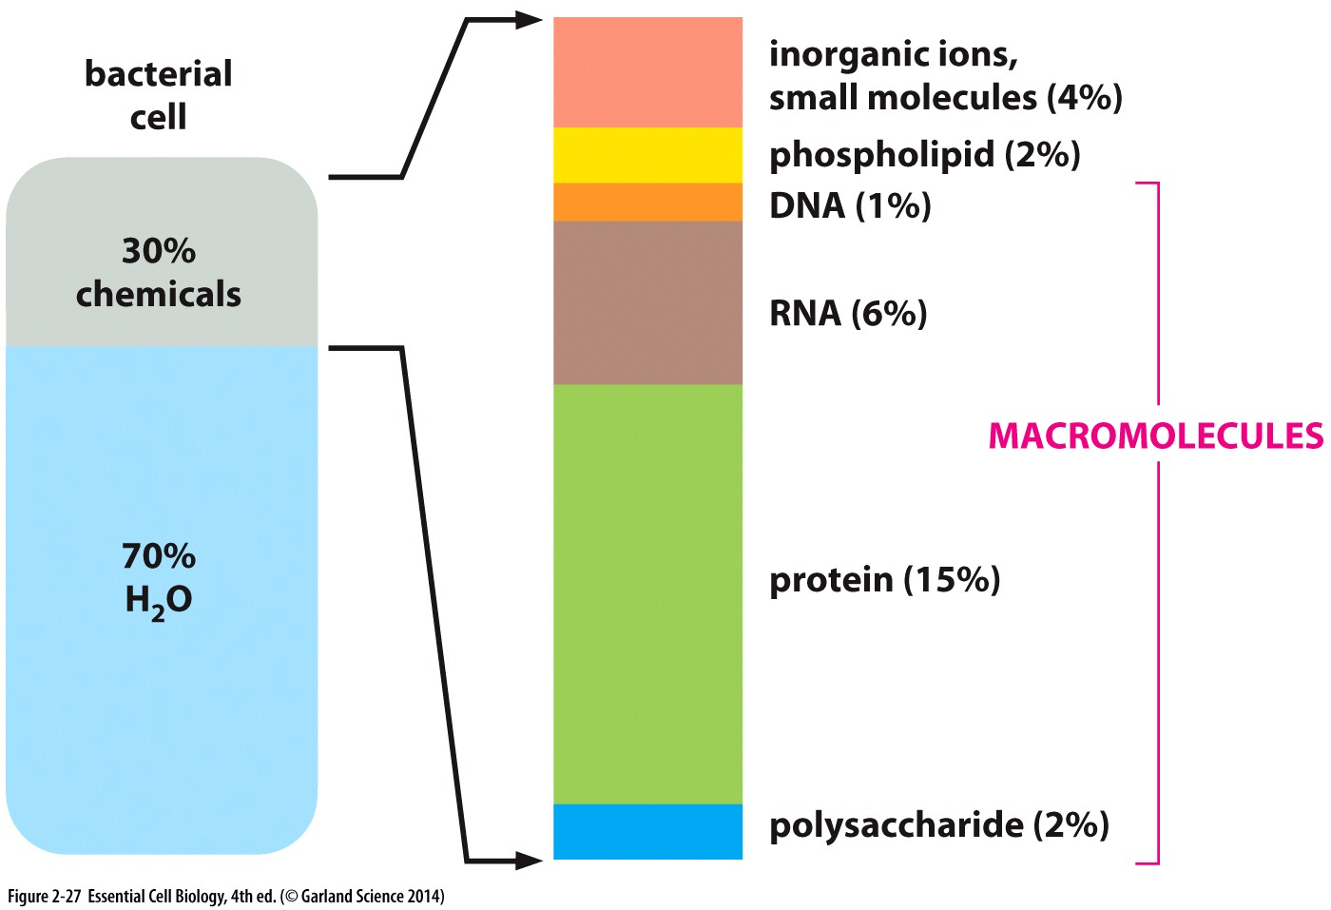
Macromolecules are abundant in cells!

Slide 30
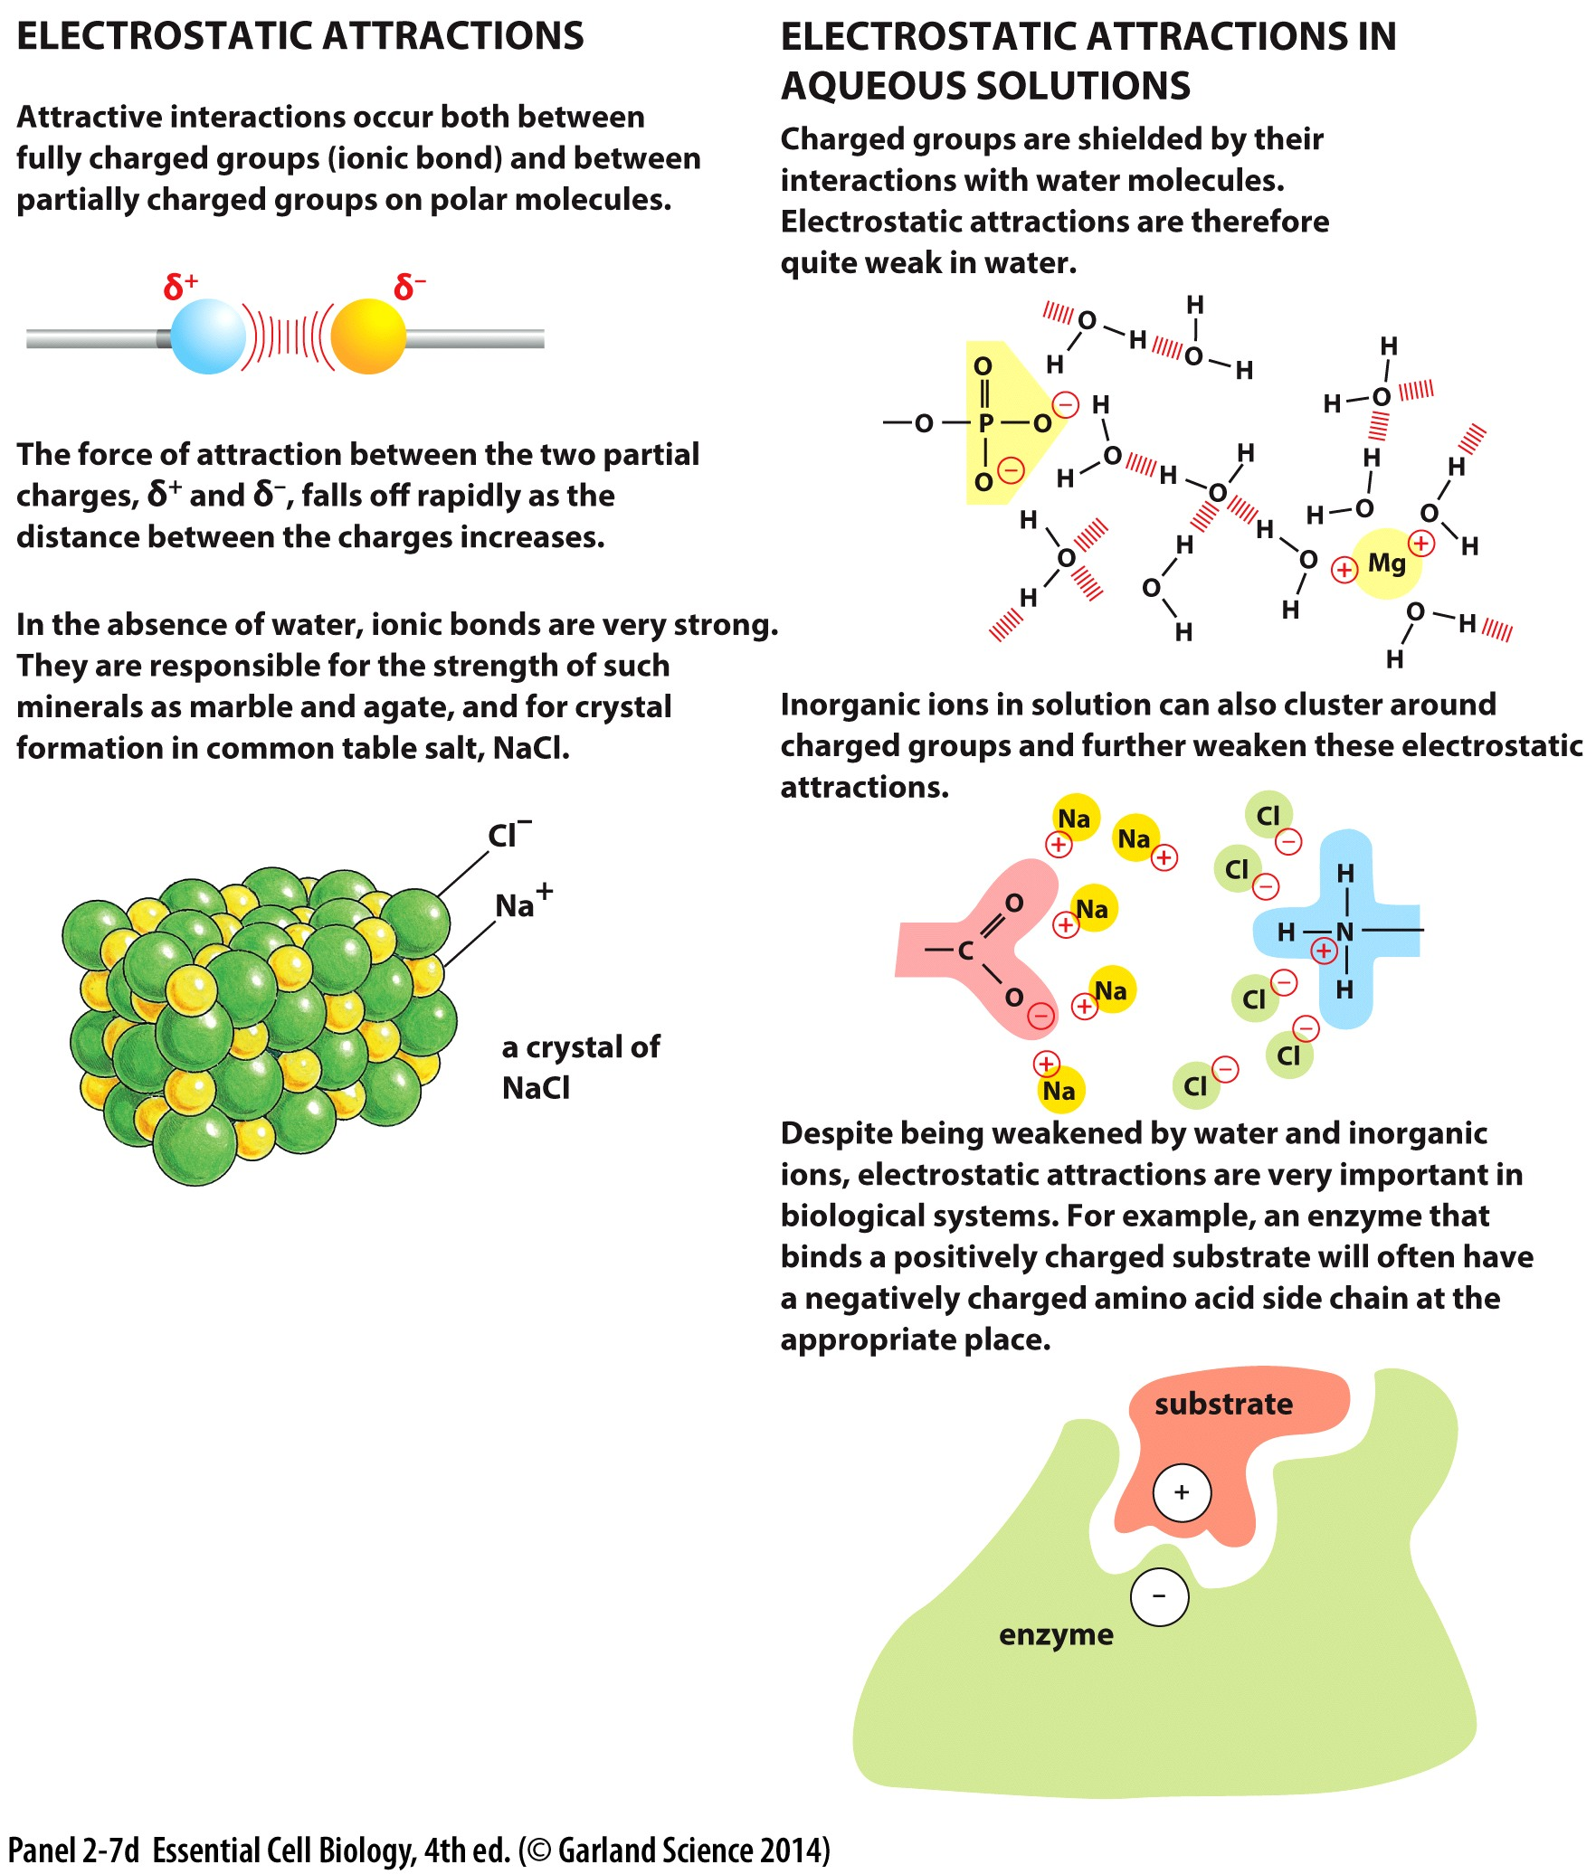
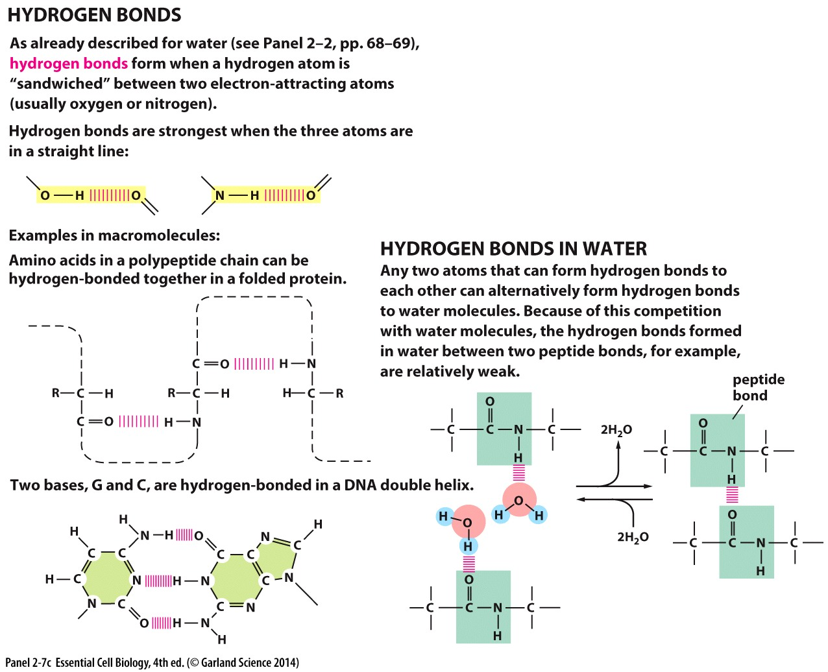
Noncovalent bonds in macromolecules
Hydrogen bonds
Between amino acids in a polypeptide chain (protein)
Between bases in a DNA chain
Electrostatic attractions
Between polar or charged groups
In an aqueous environment:
water molecules compete for hydrogen bonds
shield charged groups

Slide 31
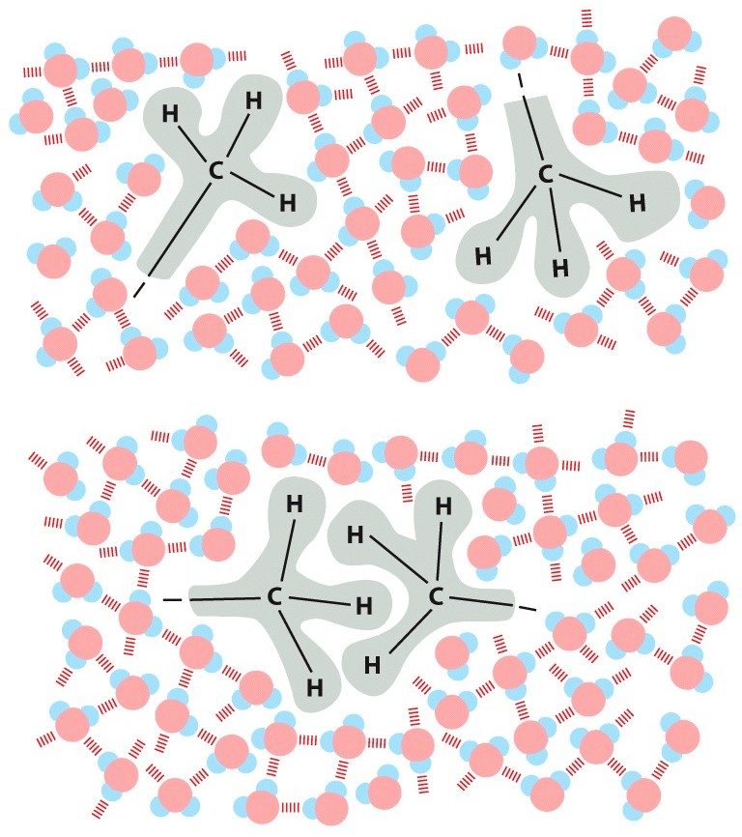
Hydrophobic interactions
Water forces hydrophobic groups together
Minimizes disruption of hydrogen bonding between water molecules
Although not a true ‘bond’ these repulsion forces can drive hydrophobic molecules together

Slide 32
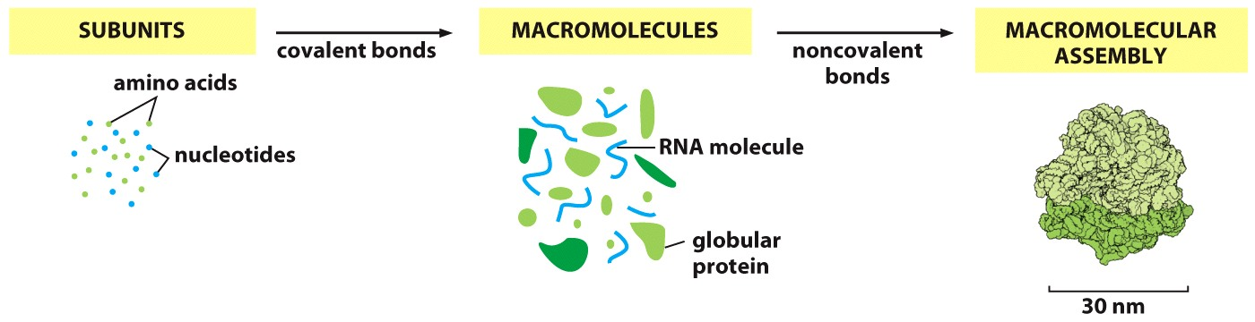
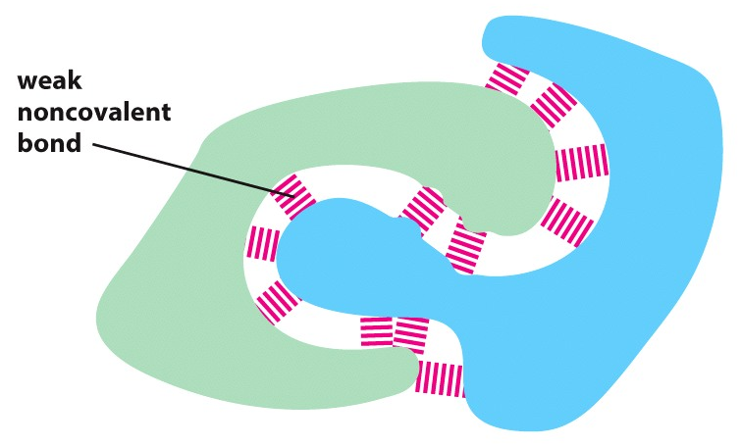
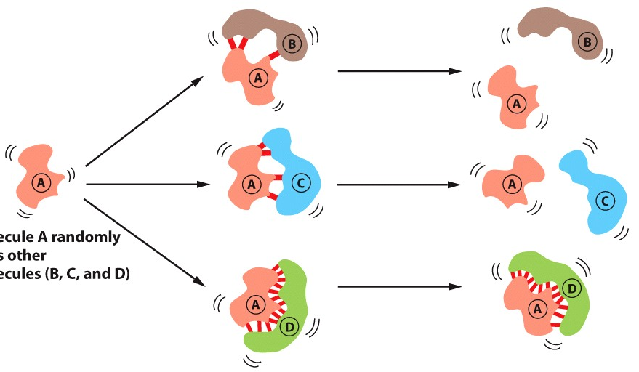
Both covalent and non covalent bonds are needed
Many weak interactions add up!
Notes:
Non covalent bonds allow a molecule to bind other molecules

Slide 33
What cellular conditions impact macromolecule assembly?
Notes:
Non covalent bonds allow a molecule to bind other molecules

Slide 35
Chapter 3 Objectives:
Understand how cells use energy: what is the source of this energy, how is it stored, and how is it used
Be able to define free energy and use measures of free energy to determine how a reaction is likely to proceed
Be able to describe and provide examples of several ways in which cells promote unfavorable reactions

Slide 36
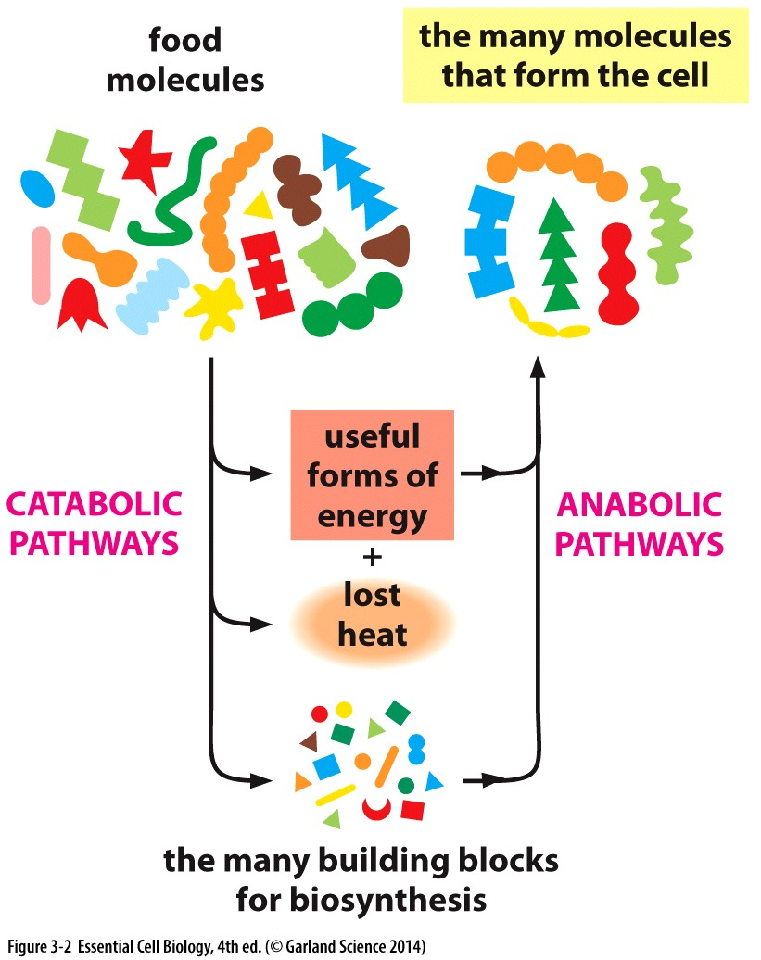
Use of Energy by cells
Physics: The universe tends towards more disordered (energetically favorable) state
Cells CREATE and MAINTAIN order
This takes energy
Where does it come from?
What does it look like/how is it stored?
How is it used?

Slide 37
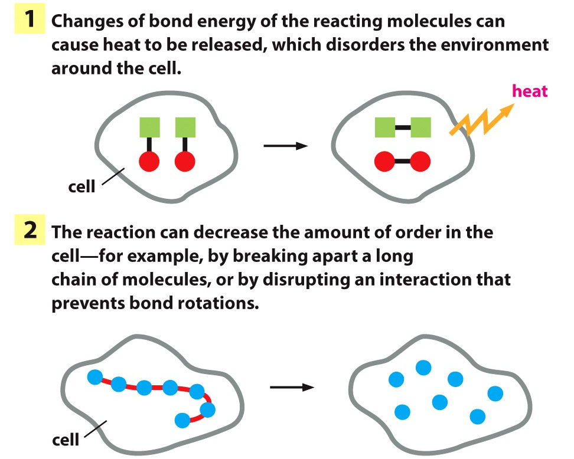
Spontaneous reactions cause disorder and release energy…
Energy can not be created or destroyed (1st law of thermodynamics)
Chemical energy in chemical bonds of organic matter (sugars and other molecules)
extract it! Harness it!

